Slide 1
Foundational Marketing: Value Propositions and Elevator Pitches

Slide 2
Topics in this workshop
Buyer personas & best clients
The buyer’s journey
Competitive differentiators
Value propositions and elevator pitches
How to tell your story
Content marketing
Advocacy
Build your marketing plan

Slide 3
Write down your answers to these questions
Who do you sell to?
Who are your best clients?
What makes you different than your competitors?
Why do your clients buy from you?

Slide 4
What is a value proposition?
The things that make your company's products and services special to your target marketplace
These statements summarize why a prospect should buy your products and services

Slide 5
Palmetto Technology Group tackles the question head on

Slide 6
Talk to your target audience

Slide 7
Communicate the advantage of your solution
7 million external emails sent each year = 7 million
opportunities to value your brand. It’s more than an e-mail signature: It’s a new channel to bolster your marketing campaigns

Slide 8
Have more than one value proposition
Another example from Palmetto Technology
If you don't want to think about IT...
Consider our monthly subscriptions for managed services. With a managed services plan, PTG handles everything from help desk requests, mobile device setup, non-functioning equipment, and server updates. We can serve as your IT team or work with your IT team.

Slide 9
Communicate your expertise

Slide 10
State the things you want prospects to know
Articulate your specialty
Describe your “wow” factors
Make it memorable
Include vertical markets and segments
Include geographic location if appropriate

Slide 11
Chances are you already have value props
Do they need refreshing?
Do they resonate with current prospects?
Do they still help close sales opportunities?
Do they still attract new prospective buyers?
Do they generate sales leads?
Use the four magic questions to create or update

Slide 12
The four magic questions
What do your clients love about your company?
What kept them awake at night that you solved?
What would they change about your company?
What are competitors doing that clients wish you did?

Slide 13
Client name:
1. What do you love about us?
2. What keeps you awake at night and how do we help you sleep?
3. If you were CEO of our company what would you change?
4. What is our competition doing that you wish we would do?

Slide 14
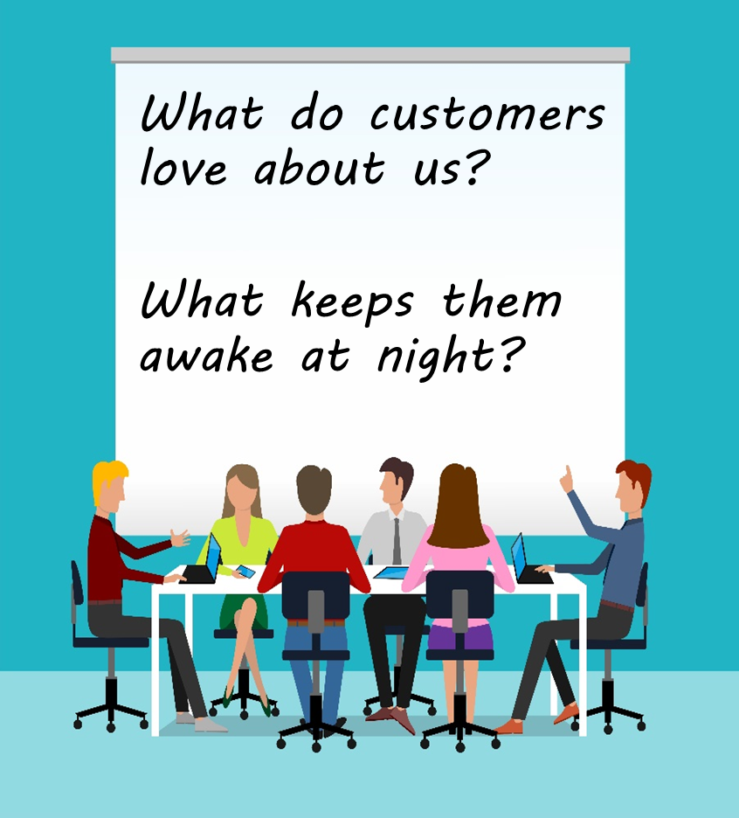
Focus on the first two magic questions
What do clients love about your company?
What kept them awake at night that you solved?
Have your team vote on responses
Analyze winning responses

Slide 15
What do our clients love about us? | Cust Supp | Sales | Mktg | Fin | Exec | Total
Response 1
Response 2
Response 3
Response 4
Response 5
Response 6
Totals | 5 | 5 | 5 | 5 | 5 | 25

Slide 16
Example of crafting a value proposition
What do clients love about your company?
You seamlessly support your solutions with quick service and deep knowledge.
What kept them awake at night that you solved?
Your solutions provided them with confidence that their data is secure and systems are in place to ensure continuity of their business operations.
Your value proposition might be:
“Our company is always on the job to protect your business from the unexpected. Our solutions are supported by our deeply knowledgeable staff who work behind the scenes to ensure that your data is safe, secure, and available without disrupting your business.”

Slide 17
Where to use your value props
Website (homepage, about us page)
Blogs
Social media
Your checkout or registration process

Slide 18
Elevator pitches
When you only have seconds to get their attention

Slide 19
What is an elevator pitch?
A short description of your company, product, solution, or its end result, that can be stated in the 15 to 60 seconds it takes to ride an elevator

Slide 20
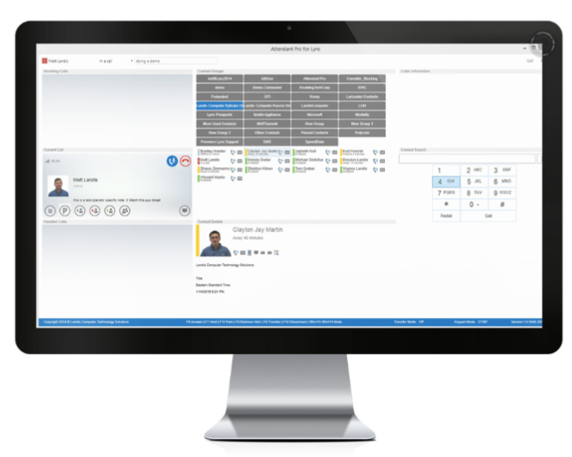
Example: Attendant Pro, Landis Technologies
A Skype for Business front end for handling incoming calls and other call management features
Their elevator pitch? We make receptionists happy

Slide 21
Generic is ok, audience-specific is better
Generic version:
Our data Visualization product transforms data into powerful charts
Audience specific version:
Financial professionals use Mekko Graphics to translate complex data into simple but powerful charts

Slide 22
Characteristics of good elevator pitches
Get their attention with a strong statement
Include your wow factors to make it memorable
Describe what you and your solutions do
Not what they are, but the advantages they deliver
Include your differentiator
Why your product, service, solution is better than all the rest
Tell but don’t sell
Keep it short and simple, you won’t close a sale in an elevator
Be prepared with an ask
What you want them to do

Slide 23
How to create your elevator pitches
Collect great phrases from your value propositions
Create variations for different audiences
Create variations for different solutions
Test variations with clients, prospects
Make sure everyone can recite

Slide 24
Let's compare
Look at what you wrote down to question of: Why clients buy from you?
How does that compare to your new or refreshed value proposition?

Slide 25
Review
Value props are what make you important to clients
They state your “wow” factors
Use four magic questions with clients and staff
Rank the best responses, craft them into statements
They should be strong and memorable
Create variations for different personas
Shorter phrases make great elevator pitches

