Slide 1
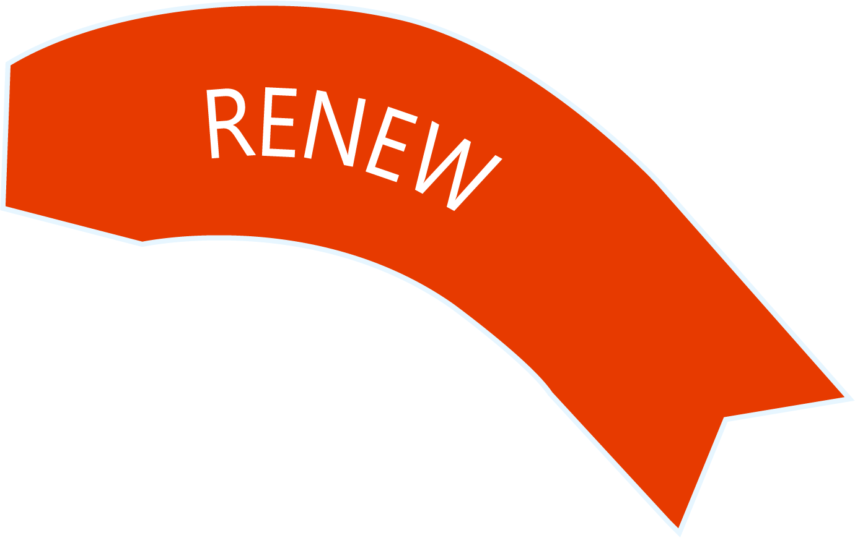
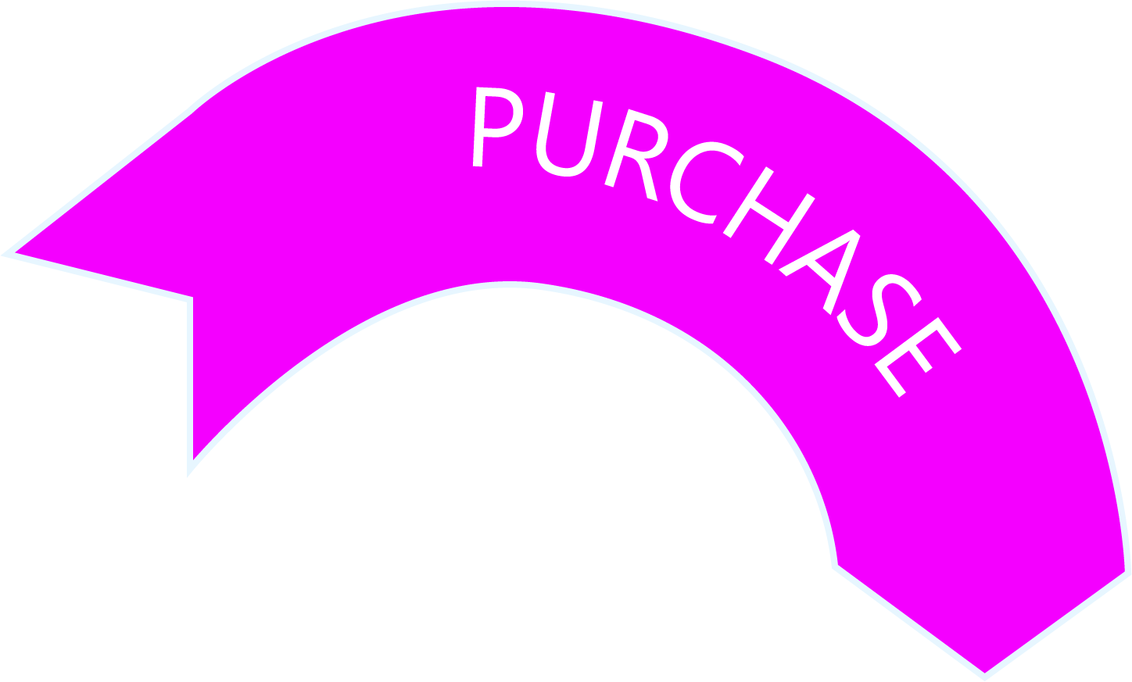
Customer experience loop
Notes:
Today’s customer is educated and has easy access to information via digital and cloud based solutions. It is vital to understand the most impactful ways to engage customers along the buying journey. There are six stages in the customer experience loop. Your job is to get your customer through this cycle as quickly and efficiently as possible. This is a series of cognitive steps, buyers can jump around, skip steps and go around again. The key here is that the buyer is trying to answer particular questions at each stage. The marketer is trying to sync with this cycle and gain competitive advantage. Let’s review each stage and then we will have you take your persona through these stages and answer questions for the award.
1. Explore Stage
Customer Goals Fit solutions to a business challenges. Could include: lowering cost; raising capacity or productivity; creating or responding to competitive threat.
Partner Goals Build unique value-add story on top of Microsoft Cloud marketing. Focus on vertical or segment (SMB/Enterprise). Drive prospects to qualifying action such as demo, event, or trial subscriptions.
2. Evaluate Stage
Customer Goals Validate and compare seller claims through demos, references, product trials.
Partner Goals Quickly qualify buying intent via digital/telemarketing. Carefully track which customers progress and invest resources accordingly
3. Purchase Stage
Customer Goal Commit to deploying the solution as soon as possible and negotiate terms and conditions
Partner Goals Provide some or all of the following to help close: quote, request for proposal and return on investment tools, case studies, customer references.
4. Expand Stage
Customer Goals Master the solutions, move from pilot to production, consider adding new functionality and user groups.
Partner Goals Provide best practices to drive success and business value. Identify internal champions and connect them to potential users. Leverage service, support, sales, and marketing to cross-sell and up-sell.
5. Renew Stage
Customer Goals Review satisfaction with the solutions and provider; assess performance and potential; decide whether to continue the relationship.
Partner Goals Reach out starting 90 days ahead of renewal date, resolve issues, evaluate up-sell and cross-sell opportunities.
6. Advocacy Stage
Customer Goals Develop a strategic partnership with the supplier, become a reference account, and actively promote success.
Partner Goals Make your customer the hero. Recruit and coach references. Arrange press and speaking opportunities. Encourage contribution to social media related to target audiences.
For more information please visit this site:
http://smartpartnermarketing.microsoft.com/customer-journey

Slide 2
Voice of the Customer – Customer Experience Interview Guide Sample
Cover phases of the Customer Experience journey (Explore, Evaluate, Purchase, Expand, Renew, Advocacy)
Do you recall how you first learned about “X solution” from us?
What made you first seriously evaluate trying “X solution”?
When it came to evaluating and buying “X solution”, where did the experience meet or exceed your expectations? Why is that?
Do you recall any interactions or aspects of your early experience that didn’t meet your expectations, or that could have gone more smoothly for you?
In your experience with support do we consistently live up to our promises to you? What makes you say that? Can you give a specific example?
What would you change, if anything, about your customer experience with us?
Have you met the business goals you have/sought to meet through your adoption of/movement to “X solution”? Why is that?
On a scale of 1-10, how easy was to do business with us?
On a scale of 1-10, how enjoyable is it to do business with us?
On a scale of 1-10, how well, overall does “X Solution” and us as a service provider meet your needs as a customer?
On a scale of 1-10, how likely are you to recommend us to a friend or business colleague?
On a scale of 1-10, how likely are you to continue using us for your Microsoft Products and Services in the next 12 months?
On a scale of 1-10, how likely are you to increase the amount you spend with us for Microsoft Products and Services in the next 12 months?
If you had the ability to choose today, would we be your first choice over other business software companies in your choice to use “X Solution”? Why is that?
When thinking about the best experiences you have as a business customer of any business, across industries/service sectors, in comparing “X Solution” and us to these experiences, where might we fall short?
Is there anything else you’d like to share?
Notes:
This interview guide is a useful starting point when conducting customer conversations.
The questions in this sample guide are based on a sample interview, and may not represent exactly all the questions that you will have.
You will need to customize your solution name ( replace X solution words ) and partner name.
In addition, the number of questions will depend on the amount of stages as well as which stages you chose to map ( for example question 1 is directly related to stage Explore, that you may or may not have).
Carefully read all of the questions and make sure you are capturing your complete customer journey ( all the stages).
Once you have adjusted the guide, and made it compatible with your journey and workload, make sure you are prepared to capture answers during the interview.

