Slide 1
Foundational Marketing: The Buyer’s Journey and Nurture Marketing

Slide 2
Foundational Marketing Topics
Buyer personas & best clients
The buyer’s journey
Competitive differentiators
Value propositions and elevator pitches
How to tell your story
Content marketing
Advocacy
Build your marketing plan

Slide 3
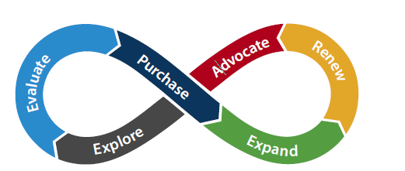
The cloud buyer’s journey

Slide 4
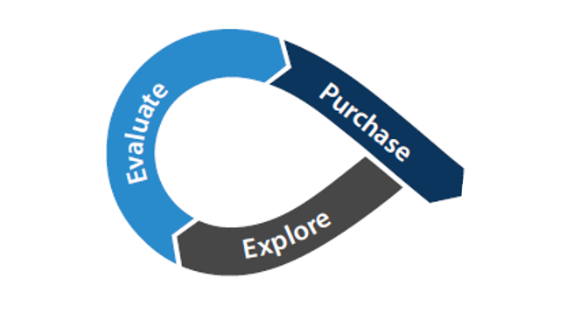
Nurturing prospects along their journey
Prospect & client acquisition

Slide 5
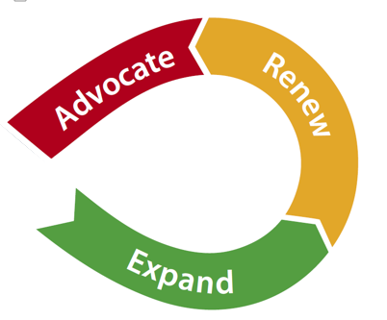
Nurturing clients along their journey
Client retention & growth

Slide 6
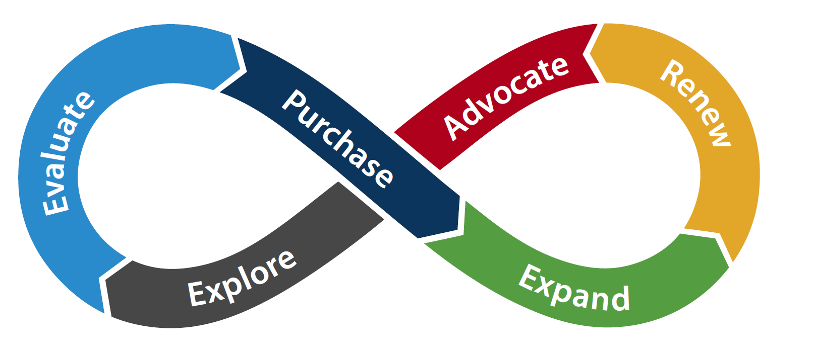
Different marketing materials for each stage

Slide 7
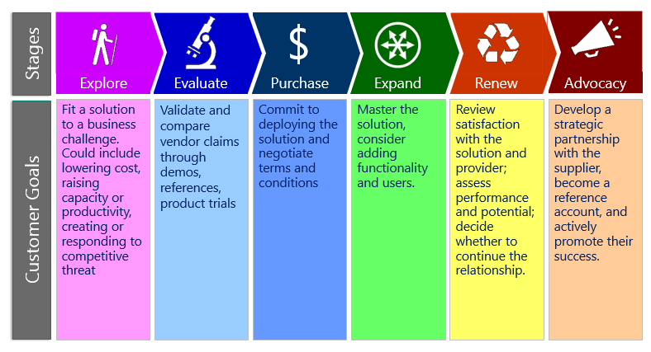
Cloud buyer’s goals per stage
Notes:
Changes to graphic:
Explore column: Looking for solutions to business challenges
Evaluate column: Comparing solutions and vendors
Purchase column: Making a decision and committing to terms and conditions
Expand column: Looking for ways to add additional functionality and users
Renew column: Evaluating satisfaction with solution and provider
Advocacy column: The buyer and vendor relationship shifts to more strategic

Slide 8
Nurture marketing
Communications for creating long term relationships
Credibility
Trust
Thought leadership
How?
Personalized communications
Educating rather than selling
Education imprints you and your company in their mind
Nurturing leads through each stage of the journey

Slide 9
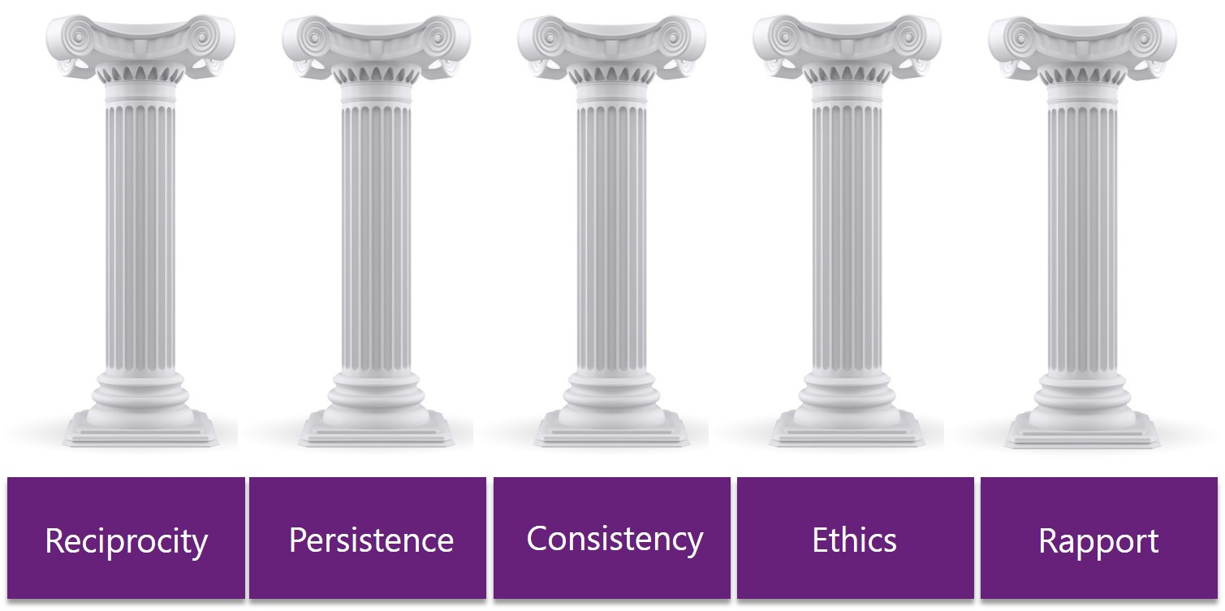
The Pillars of Nurture Marketing
Reciprocity
Persistence
Consistency
Ethics
Rapport

Slide 10
Putting this all together
Personas | Explore | Evaluate | Purchase | Expand | Renew | Advocate
Hannah HR | Specific web site pages, search optimization, Pay-Per-Click campaign, blogging | 30 day free product trial and client testimonials | Create a return on investment document regarding the value of saving 15-20 days of work each year | Teach client employees how to use self-service access to their HR benefit information | Set calendar reminder to meet with client 90 days before renewal date. | Ask client for referrals, testimonials, case study, joint speaking engagement at an HR conference

Slide 11
Review
There are six stages of the buyer’s journey
First three are about prospect & client acquisition
The next three are about client retention & growth
You need specific content and messaging for each stage of the journey, for each persona
Nurture marketing helps move them along the stages

